Slide 1
COVID-19 IN 2022
COVID-19 IN 2022

Slide 2
COVID-19
WORLD HEALTH ORGANIZATION
Defined COVID-19 as an acute disease in humans caused by a coronavirus, which is characterized mainly by fever and cough and is capable of progressing to severe symptoms and in some cases death, especially in older people and those with underlying health conditions. It was originally identified in China in 2019 and became pandemic in 2020.
MEDLINEPLUS
COVID-19 (coronavirus disease 2019) is an illness caused by a virus. This virus is a new coronavirus that has spread throughout the world. It is thought to spread mainly through close contact from person to person.
More info about COVID-19 at https://www.who.int/health-topics/coronavirus#tab=tab_1
Additional info at COVID-19 | Coronavirus Disease 2019 | MedlinePlus

Slide 3
World Health Organization
Founded in 1948, World Health Organization (WHO), is the United Nations agency that connects nations, partners and people to promote health, keep the world safe and serve the vulnerable – so everyone, everywhere can attain the highest level of health.
WHO leads global efforts to expand universal health coverage. They direct and coordinate the world’s response to health emergencies. And they promote healthier lives – from pregnancy care through old age. Our Triple Billion targets outline an ambitious plan for the world to achieve good health for all, using science-based policies and programs.
More info about WHO at https://www.who.int/about/

Slide 4
MEDLINEPLUS
MedlinePlus is a service of the National Library of Medicine (NLM), the world's largest medical library, which is part of the National Institutes of Health (NIH).
Our mission is to present high-quality, relevant health and wellness information that is trusted, easy to understand, and free of advertising, in both English and Spanish. Anywhere, anytime, on any device—for free.
More info about MedlinePlus at https://medlineplus.gov/about/

Slide 5
10 POSITIVE
COVID-19 SCENARIOS THAT MIGHT HAPPEN IN 2022

Slide 6

Face to Face Classes
With the successful pilot testing of limited face to face classes during 2021, the Duterte administration economic managers are seeing the resumption of face-to-face classes by January 2022
1
Source at Duerte economic managers see resumption of in-person classes in January 2022 | Inquirer News

Slide 7

Economic Growth
2
With the return of businesses in late quarter of 2021, Security Bank Assistant Vice President and Chief Economist, Robert Dan Roces, expects a strong economic growth in the year 2022. According to Mr. Roces, they foresee the Philippines GDP growing by 6.5 percent on a year-over-year basis in 2022 as we head towards the normalization of our daily lives.
Source at PHL to grow 6.5 percent in 2022, economist says | Bianca Cuaresma (businessmirror.com.ph)

Slide 8


Contact Sports
3
With Metro Manila being under alert level 2, contact sports are allowed provided that it is approved by their Local Government Unit. Since sports are now allowed in some places, Filipinos will have more option on playing contact sports and improve their physical fitness compared on playing online games inside their houses.

Slide 9
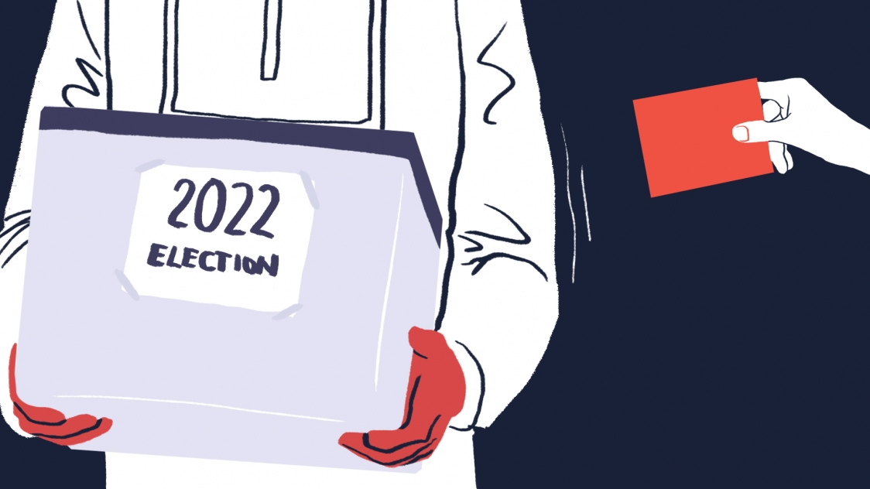
Election 2022
4
Every six years we, Filipinos, hope for a leader who will sacrifice his/her self for the benefit of the country. With the upcoming 2022 Election, Filipino will have another hope for a brighter future we all want. We will be given another chance to choose leaders who will lead the country to its success.

Slide 10


Religious Gatherings
5
Since COVID-19 lockdown, religious gatherings have been diminished due to the virus of COVID-19. As we enter a new year, we believe that religious gathering will be one of the priorities of our government in the year 2022.

Slide 11

Theme Parks
Since theme parks are now allowed, I believed that children would enjoy the theme parks we have here around the country. It would be beneficial for the family and for the economy of our country.
6

Slide 12
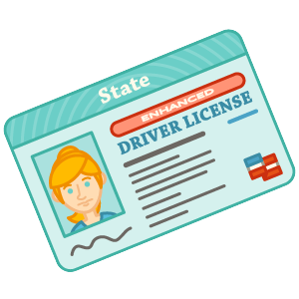


Licensure Exams
7
Every six years we, Filipinos, hope for a leader who will sacrifice his/her self for the benefit of the country. With the upcoming 2022 Election, Filipino will have another hope for a brighter future we all want. We will be given another chance to choose leaders who will lead the country to its success.

Slide 13
Social Events
2022 will be one of the most memorable events for the debutants, celebrators, and party goers because during the late 2021 the government allowed venues for social events. We believed that the year 2022 is the perfect time for us to celebrate things.
8

Slide 14
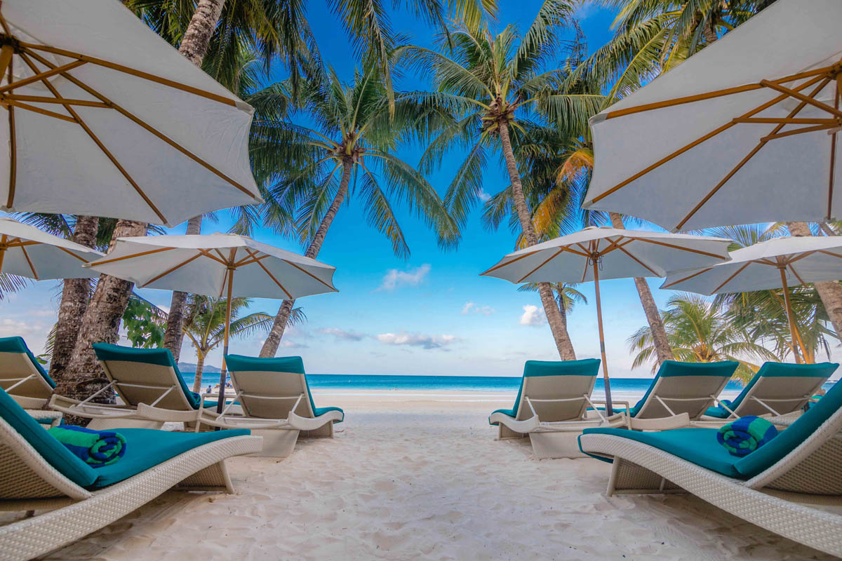

Tourist Attractions
9
As some famous tourist spots softly reopens in late 2021, we believed that the year 2022 will be one of the most prosperous years for our famous landmarks here in the Philippines. This will also help us in recovering our economy since we have lots of tourist attractions here in the country like Boracay, Siargao, El Nido, and many more.

Slide 15


Work
10
With the return of some businesses in 2021, 2022 is the perfect year to return most of the businesses in the country. If this happen, it will bring more opportunities for our countrymen to have work.

Slide 16
Once you replace negative thoughts with positive ones, you’ll start having positive results.
-Willie Nelson

Slide 17
END OF PRESENTATION
END OF PRESENTATION

